Slide 1
Voyeur
The ground truth editor

Slide 2
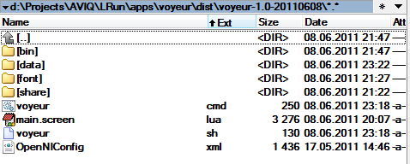
The files user needs to know
Program starter
Data files directory. Use this directory to manage your .knd files.
Holds movie of one or more recorded sessions. Each frame may have 16 bit depth, 24 bit rgb image, 16 bit labels and 24 skeleton 3D points. Frame size is 640x480.

Slide 3
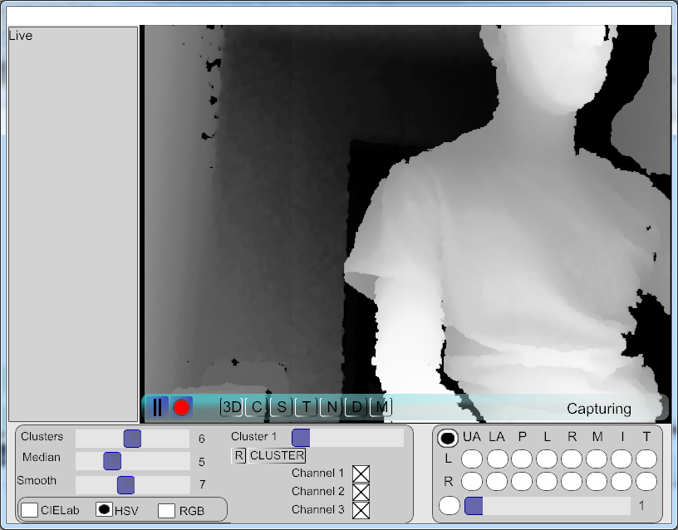
Start Recording
Press record button

Slide 4
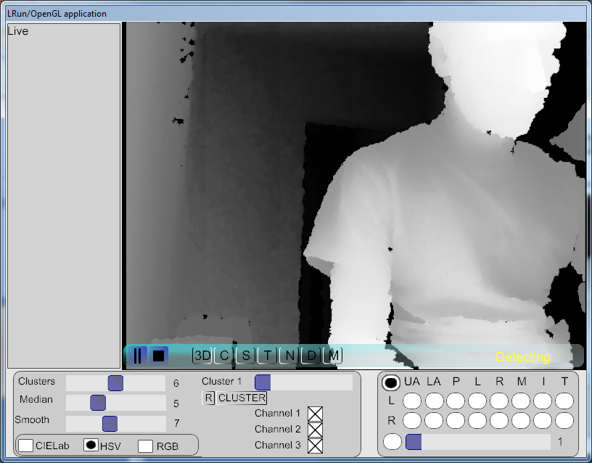
Recording standing by…
Before recording starts, user skeleton must be detected
Press record button

Slide 5
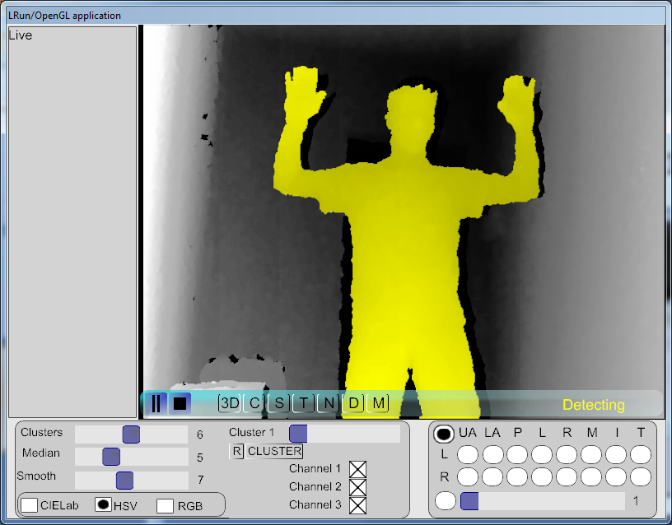
Show pose Ψ
Before recording starts, user skeleton must be detected
Press record button

Slide 6
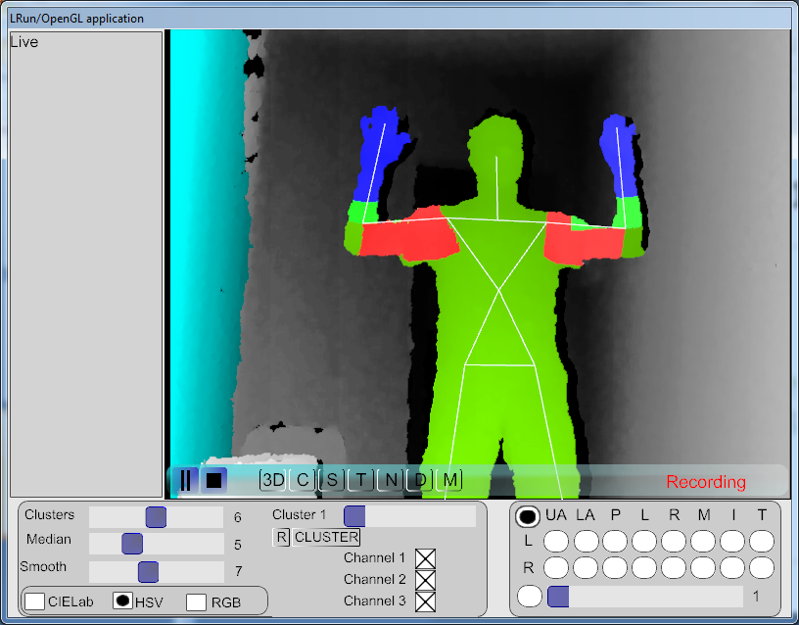
Recording started
Before recording starts, user skeleton must be detected
Press record button

Slide 7
Stop Recording
Press record button
Press stop button

Slide 8
Manage your recording files
Recorded file is now in data/Recorded.knd
Exit the program with pressing key ESC
If desired rename data/Recorded.knd to human readable name (e.g. <actorname>_1.kng)
Start the program again
Press record button

Slide 9
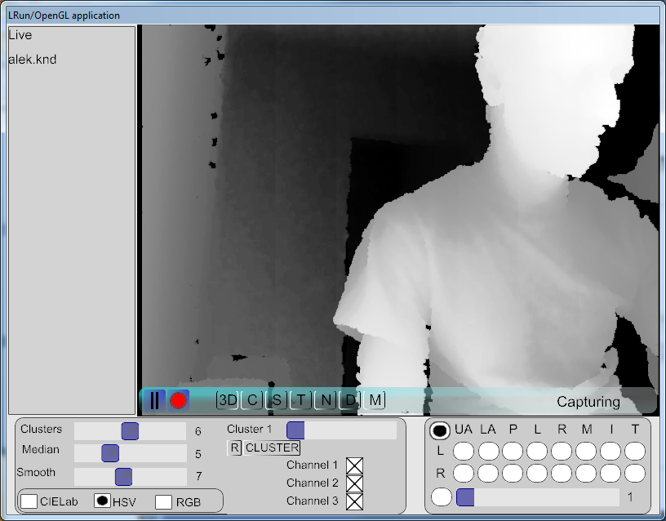
Review recorded files
Click to play live
Click to play the recorded file
Press record button
Press stop button

Slide 10
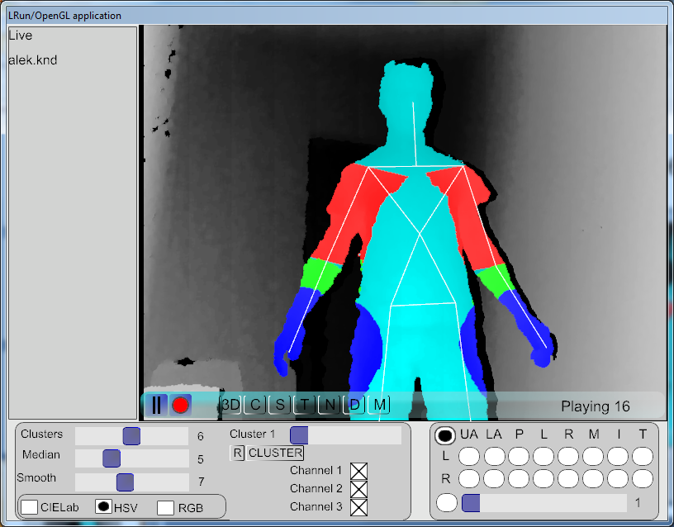
Review file frame by frame
2. Single click on the image to review the movie frame by frame
1. Press pause

Slide 11
Turning on RGB images
After the program starts if this button has been pressed at least once, the RGB camera starts to be used. RGB images will be added to recordings. Unpressing the button will not change this behaviour, but will only acts visually.
Press button “C”

Slide 12
Deleting unwanted frame
This operation may take time if the frame is in the beginning of really large file.
Press ‘D’ button

Slide 13
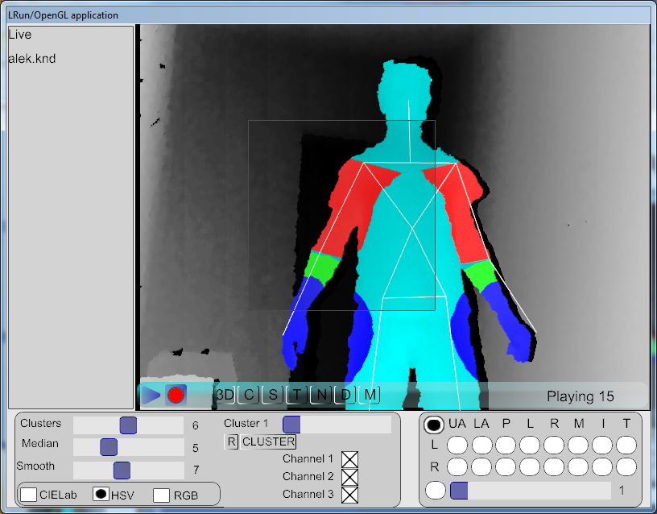
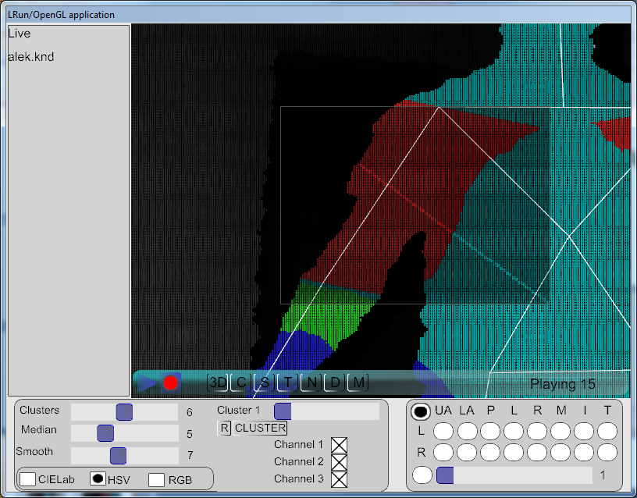
Zooming
1. Drag area with the mouse
2. You can zoom more than once
3. Right click to unzoom

Slide 14
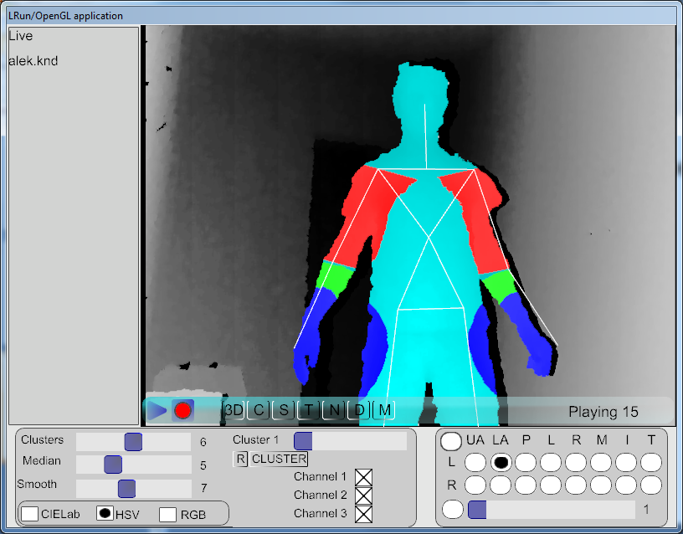
Paint labels – enter marking mode
Set ‘M’ button to pushed state
In marking mode the mouse stops acting as “show next frame” or “zooming”, but will add points to polygon.

Slide 15
Paint labels – select label
Select a label

Slide 16
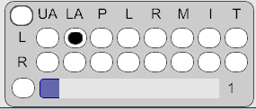
Labels description
KN_LABEL_NONE
/* left hand segments */
KN_LABEL_LEFT_UPPER_ARM = 16,
KN_LABEL_LEFT_LOWER_ARM,
KN_LABEL_LEFT_PALM,
KN_LABEL_LEFT_FINGER_LITTLE,
KN_LABEL_LEFT_FINGER_RING,
KN_LABEL_LEFT_FINGER_MIDDLE,
KN_LABEL_LEFT_FINGER_INDEX,
KN_LABEL_LEFT_FINGER_THUMB,
/* right hand segments */
KN_LABEL_RIGHT_UPPER_ARM = 24,
KN_LABEL_RIGHT_LOWER_ARM,
KN_LABEL_RIGHT_PALM,
KN_LABEL_RIGHT_FINGER_LITTLE,
KN_LABEL_RIGHT_FINGER_RING,
KN_LABEL_RIGHT_FINGER_MIDDLE,
KN_LABEL_RIGHT_FINGER_INDEX,
KN_LABEL_RIGHT_FINGER_THUMB,
KN_LABEL_BODY_1..15

Slide 17
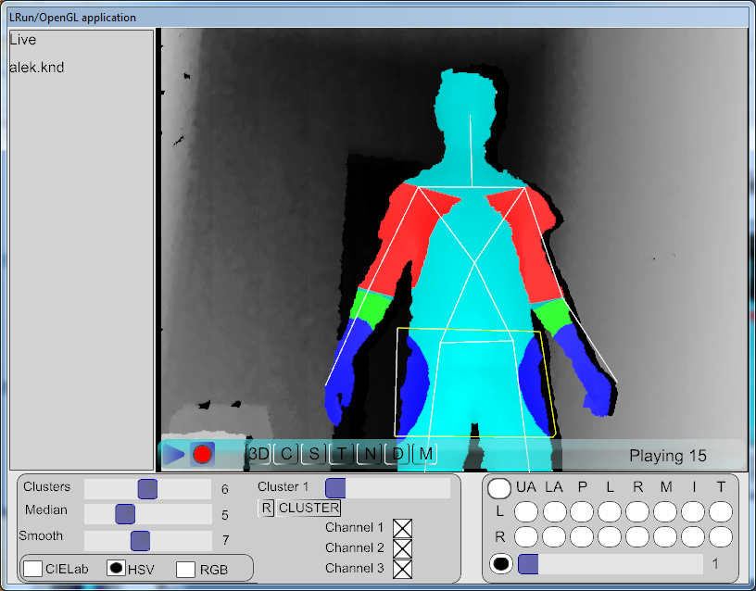
Paint labels – marking polygon
1
2
4
3
While in marking mode (M button is pressed), select desired label and start clicking on the image to select the polygon edges. To start selecting regions for another label, keep in M-mode, select the new label and make the polygon for the new label.

Slide 18
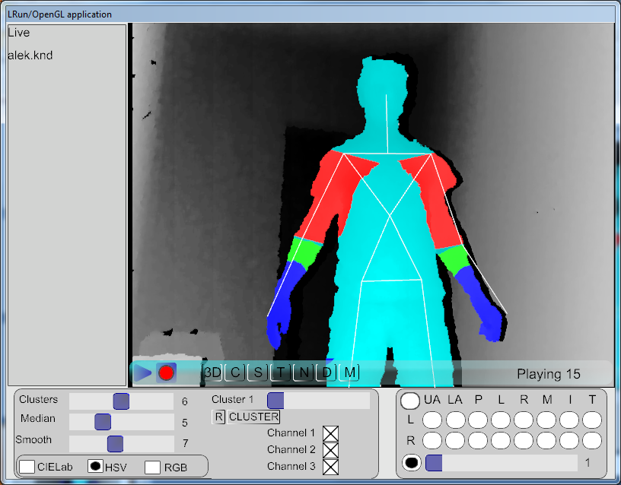
Paint labels – filling polygon
Set ‘M’ button to unpushed state
After unpressing ‘M’ (leaving M-mode) all polygons get filled with the corresponding label. Keep in mind this changes the image only in memory.

Slide 19
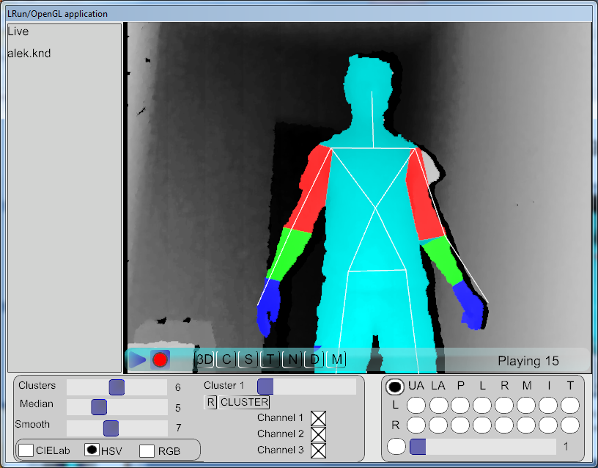
Paint labels – save frame
Set ‘M’ button to unpushed state
Press ‘S’ to save the changes
Your changes on the frame are now saved to the file.

Slide 20
Best known marking practice
Process only one label per frame.
For all desired labels do multiple passes on the file
Save each polygon
Example steps:
Press M (enter M-mode)
Select e.g. label Body 1
Mark polygon on the body
Press M (leave M-mode)
Press S (save)
Click on the image to view next frame
Continue until all frames finish
Starts from the beginning to correct new label
Set ‘M’ button to unpushed state

